Slide 1
Lear Logistics Requirements
North America

Slide 2
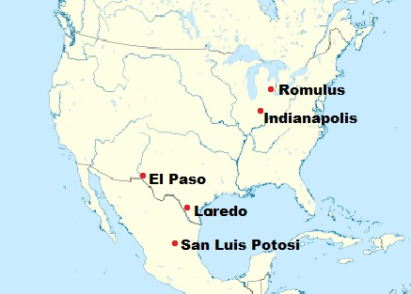
Lear North America (N.A.) Logistics Network
Lear uses a network of crossdocks to optimize inbound freight for both Seating and E-Systems plants in North America.
The Network consists of five facilities:
  Romulus, MI
  Indianapolis, IN
  El Paso, TX
  Laredo, TX
  San Luis Potosi, MX
Service Providers:
  Penske:
    Operations Lead Logistics Provider
    Carrier Sourcing/Management
    Key Contact Role: Penske Supply Chain Manager (SCM)
  Agillence:
    Logistics Engineering
    Network Optimization
    Key Contact Role: Agillence Logistics Engineer (LE)

Slide 3
N.A. Logistics Requirements
Lear approved labeling
  Supporting Document(s):
    North America Lear Label Requirements (within our Packaging section).
Pallet stack-ability / standardized component packaging
  Supporting Document(s):
    Supplier Packaging Requirements & Guidelines
Electronic Advanced Shipping Notice (ASN) – EDI
Packing Lists, Bills of Lading, Commercial Invoices and Customs Paperwork
Supplier Routing / Packaging

Slide 4

Electronic ASN - EDI
ASNs must be sent out within 20 minutes of shipment departure
ASNs must be electronically sent to Lear’s final destination
An ASN must be submitted per shipment per plant
ASN required elements:
Part Number
Quantity
Trailer Number
Time & Date Shipped
Packing List Number
Lear Plant Destination
Shipment Gross Weight

Slide 5
ASN – Submission Guidelines
To find instructions for sending ASNs (EDI):
Visit www.lear.com
Click Suppliers
Click ONLINE
Click Web Applications
Click EDI Guidelines
Select your region
Select your plant
Expand EDI Files
Click the Dispatch Advice / Delivery Transport Data Guideline to access detailed information.

Slide 6
Required Shipping Documents
The following documents are required to be sent to each final Lear destination:
Packing List:
  Must match the ASN and must include the correct gross weight, must include Lear Plant, and must be attached to pallet in a packet
Commercial Invoice:
  Required for all cross-border shipments
Bill of Lading:
  Must be one BOL for the entire shipment including all final locations
All documents must be printed (hand-written is not accepted)
Drivers must be provided each document to present at cross-dock
Commercial invoice / Packing list must be completed timely & accurately, and sent separately for each final Lear destination (a separate, exclusive document for each destination)

Slide 7
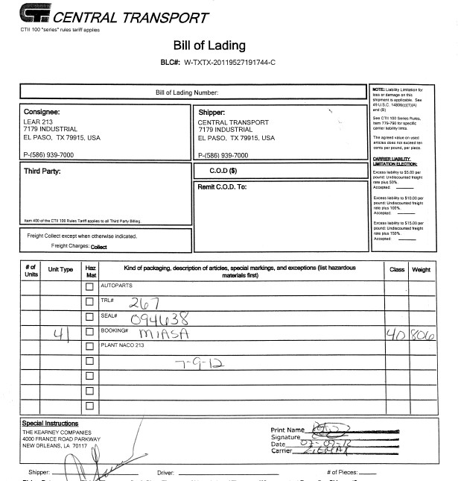
Single Plant BOL – Current Process

Slide 8
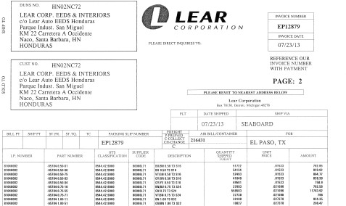
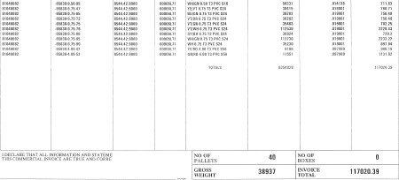
Commercial Invoice - Example

Slide 9
Required Shipping Documents – BOL’s
The Bill of Lading must contain the following:
  Description of Goods per Package
  Type of Package: Box or Pallet
  Dimension of the Package: L x W x H
  Unit of Measure: Meters or Inches
  Net Weight and Gross Weight
  Unit of Measure: Kilograms or Pound
BOL’s must also contain the Final Destination (Lear Plant) as well as the cross-dock address in the consigned area
Examples:
Correct consignee :
Lear NACO – 213
c/o Ceva Logistics 950 Loma Verde Way El Paso, TX 79936
Incorrect consignee:
Ceva Logistics
950 Loma Verde Way El Paso, TX 79936 USA

Slide 10
Required Shipping Documents - VGM (Ocean Carriers)
SOLAS (Safety of Life at Sea)
SOLAS requirements provide that every shipper must submit an accurate Verified Gross Mass (VGM) of each ocean container to the carrier in advance of the stow planning process
Carriers must use the VGM in vessel load planning, and together with the terminal operator, to ensure that any container that does not have a VGM is not loaded on board a vessel
Terminal operators will also perform random weight checks to confirm accuracy of the VGM weight declared by the shipper, and inaccurate weight submissions will subject the shipper to monetary penalties
Lear will only accept VGMs calculated pursuant to Method 2, which requires the shipper to weigh each individual item, the packing materials, and add the ocean container tare weight to arrive at the VGM provided on the certification document.
Details can be found on Lear’s Supplier Portal, under Supplier Web Guides at www.lear.com. Suppliers not in compliance with this new IMO regulation will be responsible for any costs or expenses arising out of shipping delays, premium freight costs, and port charges resulting from non- compliant VGM shipments.

Slide 11
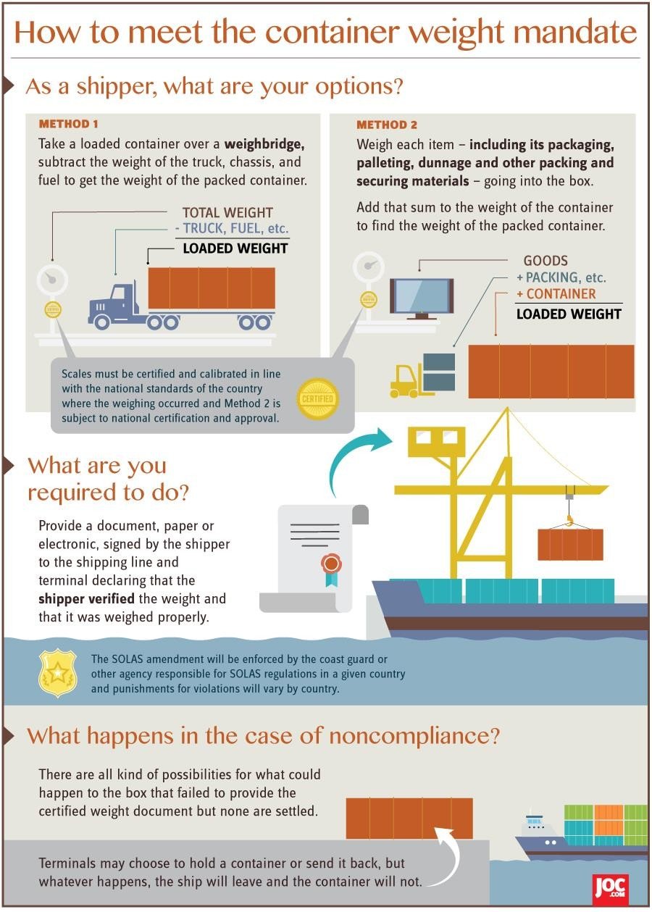
Required Shipping Documents - VGM (Ocean Carriers)

Slide 12
Global Supplier Compliance / Routing Info
Global Logistics’ supplier routing instructions must be followed
  Instructions identify standard carrier, shipment day, shipment mode, detailed
  shipping requirements, etc.
  Upon receipt, instructions must be reviewed, signed, and returned
  If necessary, contact respective Lear plant for expedited shipping instructions (Premium Transportation Authorization # required)
Contact information:
  Lear Transportation Operations
  Luis Perez (lperez04@lear.com / 915-787-7679)
  Tony Vega (Avega@lear.com / 915-787-7752)

Slide 13
NA Supplier Routing Instructions - Example
When routing changes or is implemented, supplier will follow Agillence provided Routing Instructions.
  Suppliers shipping outside of Routing Instructions is not allowed (other than authorized PTA from Lear facility)
  Note: Routing Instructions are final, and are required to signed and returned to Agillence
Suppliers must ship with carriers as shown on their Routing Instructions
  Any exceptions are required to be managed by Penske
Additional costs generated by missed ship-days or window times will be suppliers’ responsibility
Additional costs generated by the use of incorrect transportation mode will be suppliers’ responsibility

Slide 14
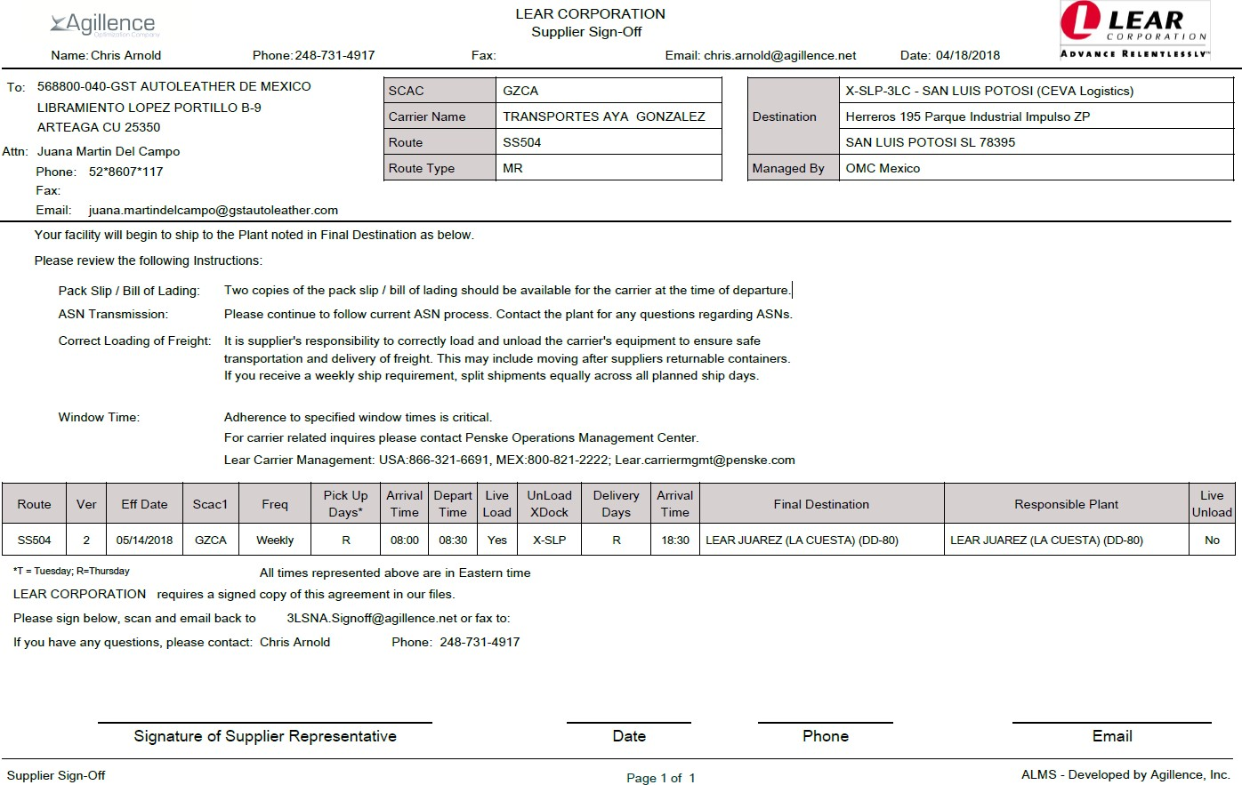
NA Supplier Routing Instructions
Supplier Shipping Point
Mode of Transportation
Shipping Requirements
Destination Point
Supplier specific Ship day
Must be signed & returned

Slide 15
Additional Recommendations
Prior to first shipment it is imperative to contact Lear to verify the following:
Lear Designated Transportation Carrier & Customs Broker (if applicable)
  Confirm supplier routing instructions
Documentation / EDI
  Confirm bill of Lading requirements
  Confirm commercial invoice details
  Confirm ASN and delivery window requirements
  Confirm overall EDI requirements / connections
Packaging
  Confirm approved packaging design(s) & density(ies)
  Confirm minimum order quantity(ies) – stackable level pallet layers

Slide 16
Frequently asked questions
See supporting document “North America Frequently Asked Questions”

Slide 17
Thank You

